Slide 1
Grandparents are a delightful blend of
Laughter,
Caring deeds,
Wonderful stories,
And Love!
Happy Grandparents Day
From, The Students of Caribbean School 2016

Slide 2
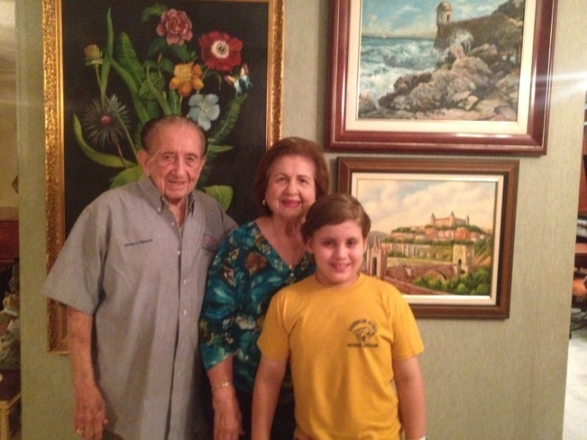
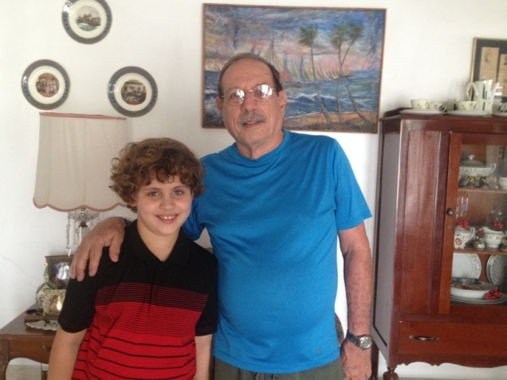
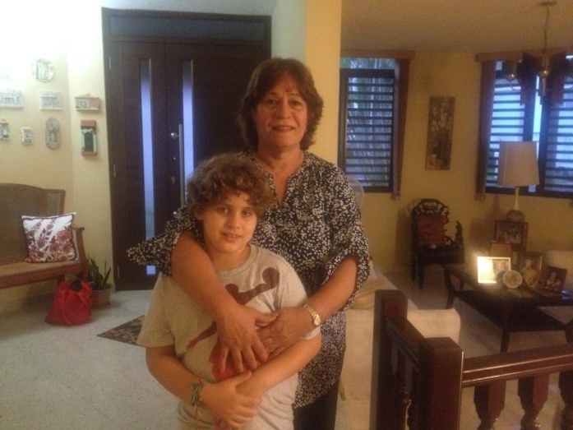
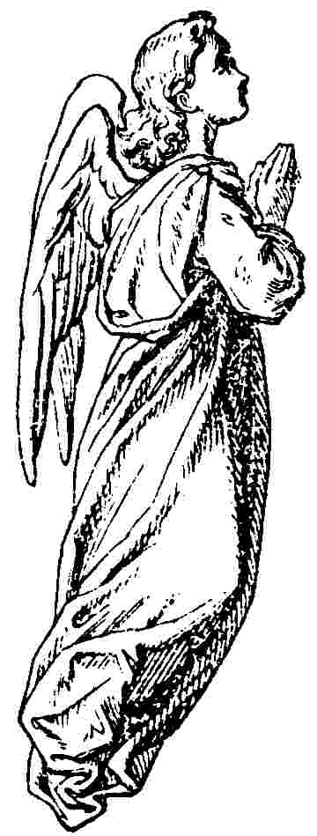


I love you because you take me to Disney and different countries.
Love Efrain

Slide 3
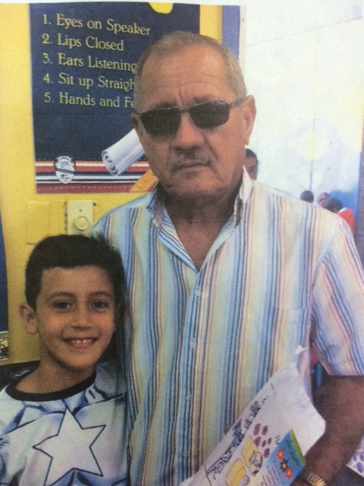
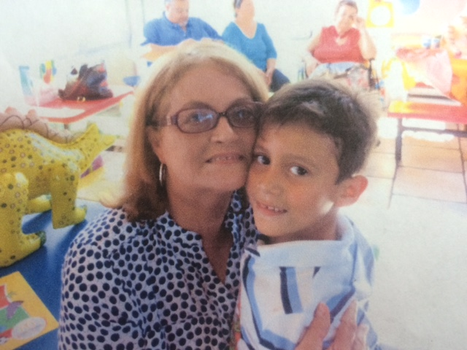


I Love you because you make me smile when you make me happy.
Love Gustavo.

Slide 4
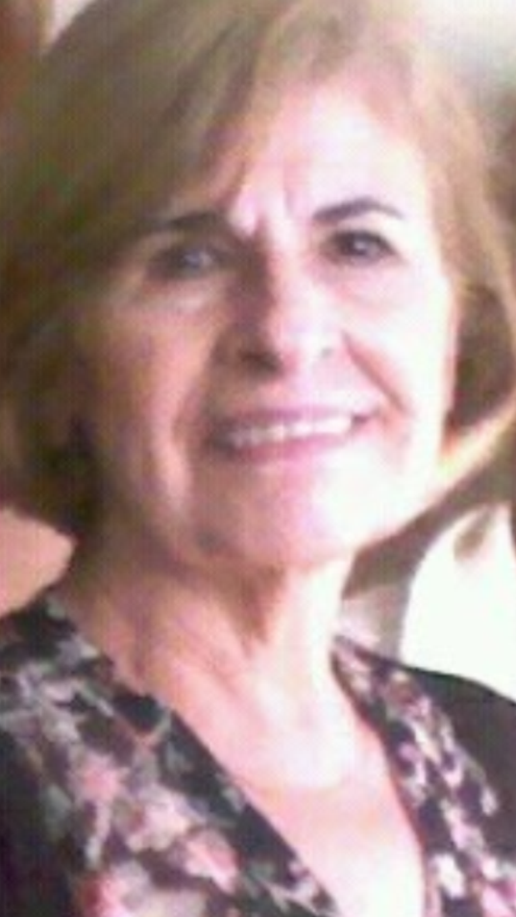

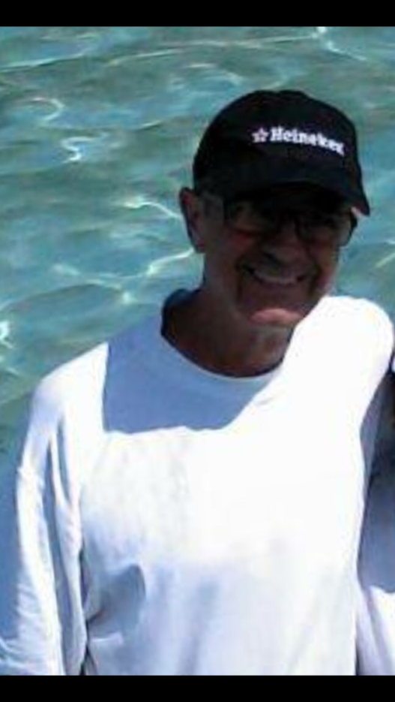
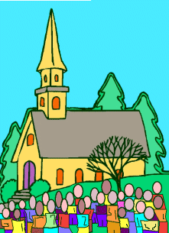
I love you because you take me to volleyball and supermarkets.
Love Amanda

Slide 5
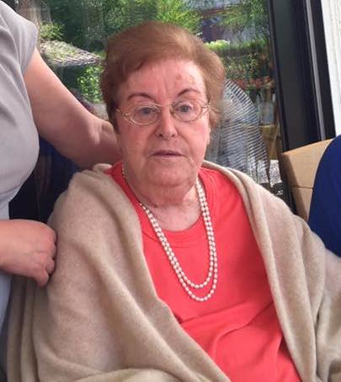
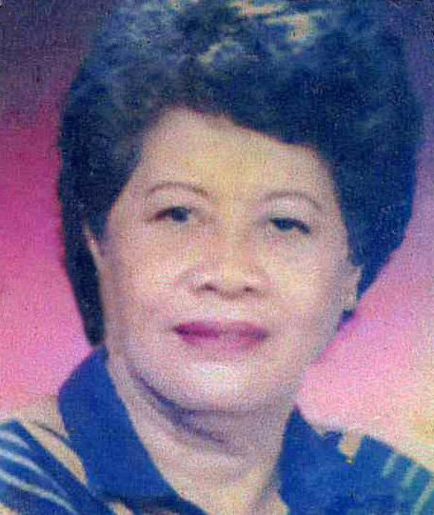
I love you because you are the best at taking care of my dad!
Love JUERGEN

Slide 6
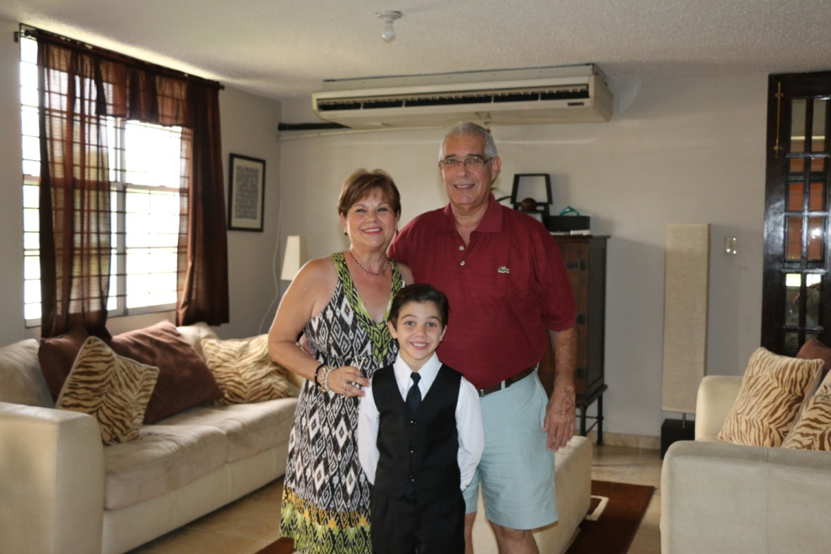
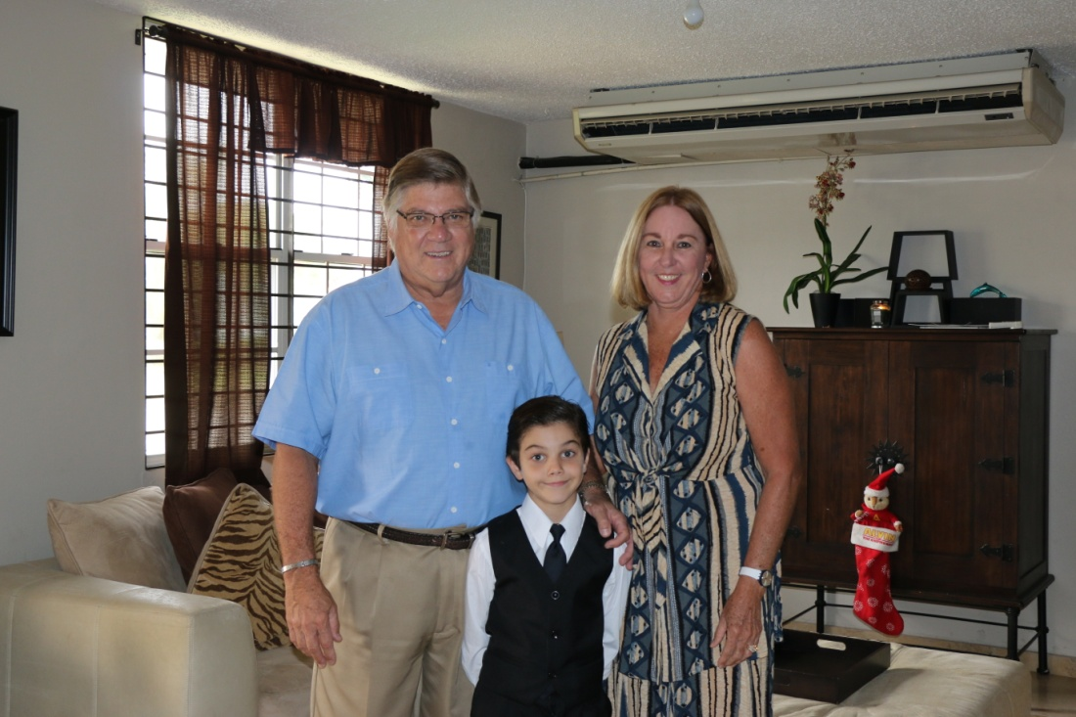

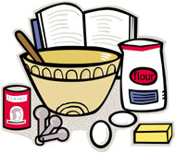
You era special because you took me to North Carolina Love Sebastian

Slide 7
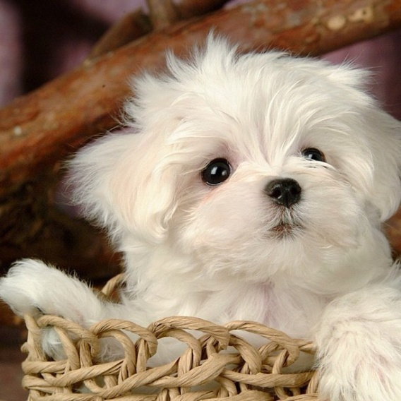
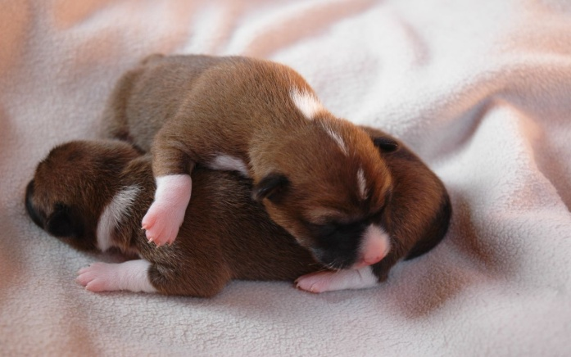
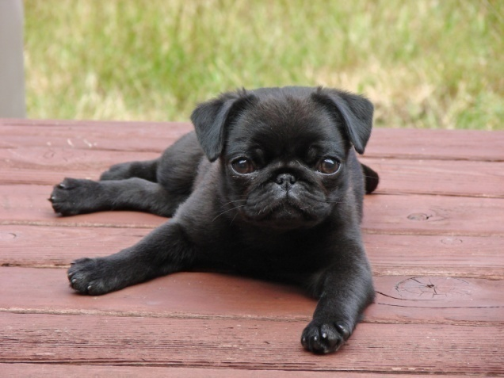
Happy Grandparent’s Day. I love you because you always take care of me. Love, Alejandra

Slide 8
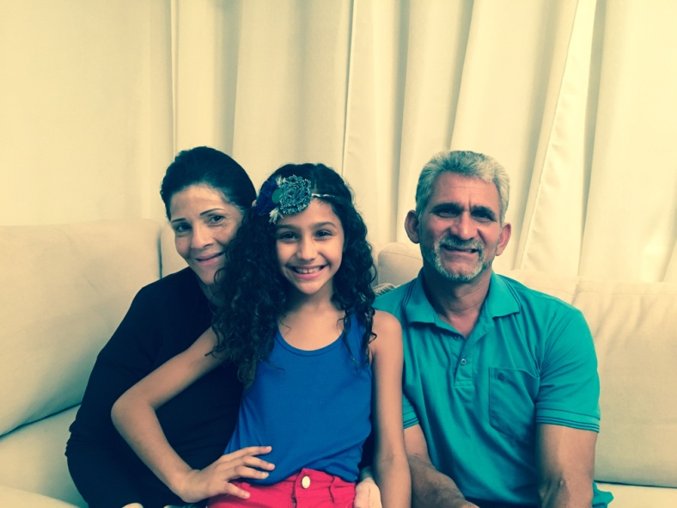

I love you because you teach me how to behave.
Love Mia!

Slide 9
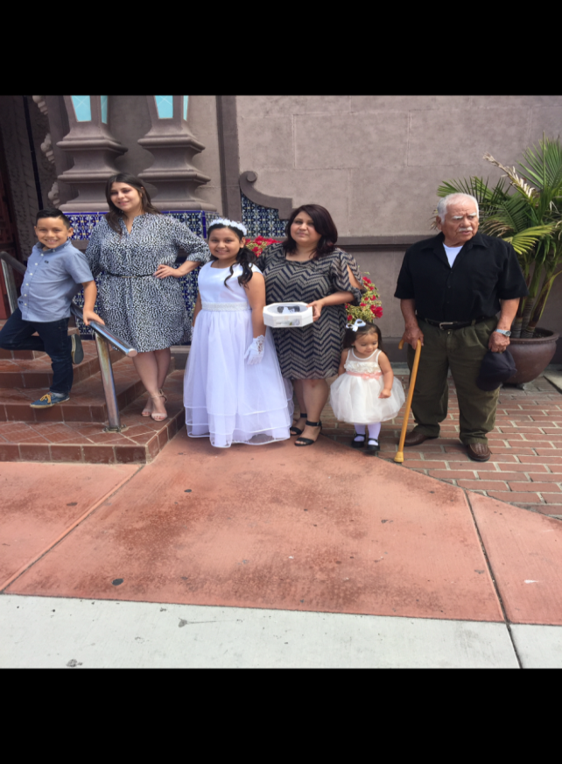
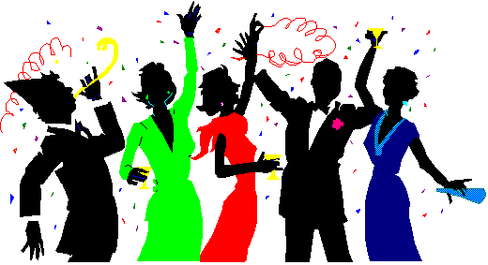
I love you because you make me smile when you take care of me and when you make me food. LOVE Aaron!

Slide 10
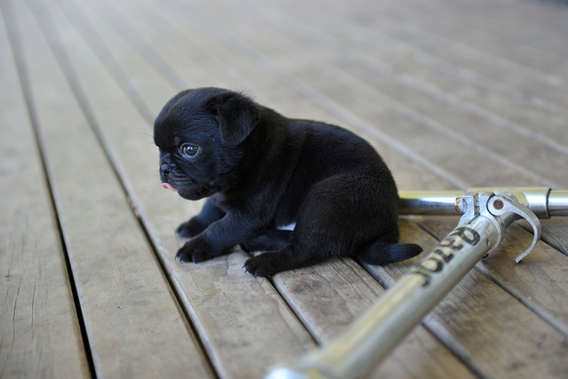
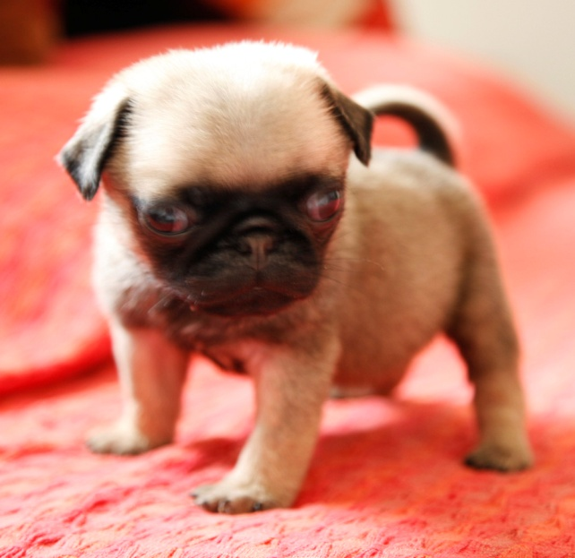
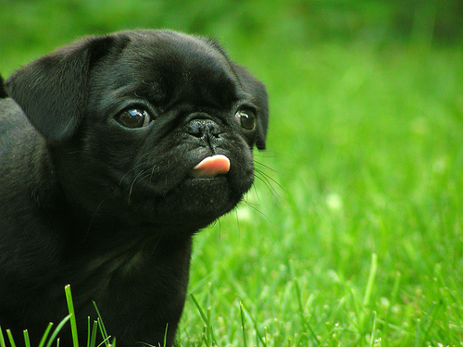
I
love you because you make me laugh when you tell me jokes.
ALEK#YAVI

Slide 11
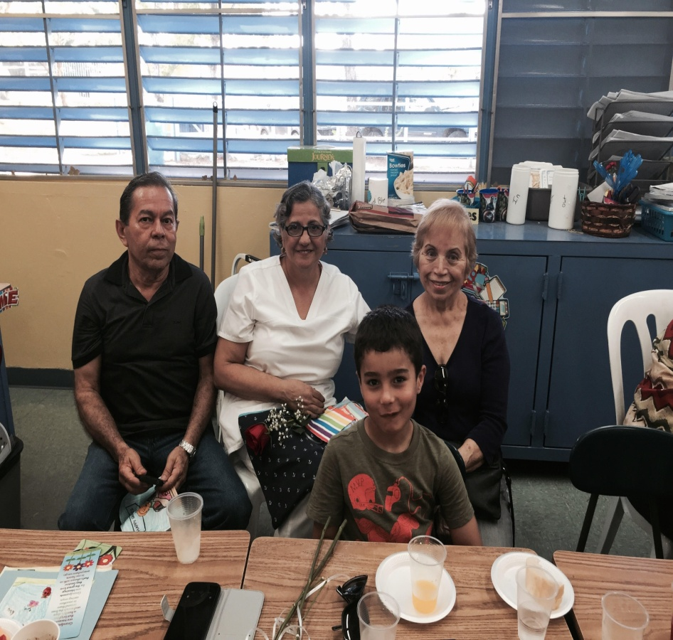
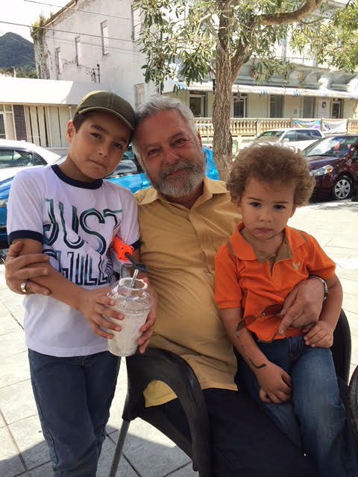
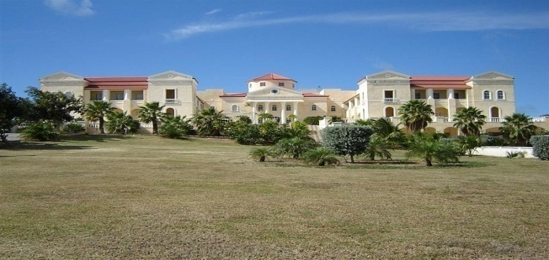

I love you because you make me laugh when you tell funny stories! Love Jean

Slide 12

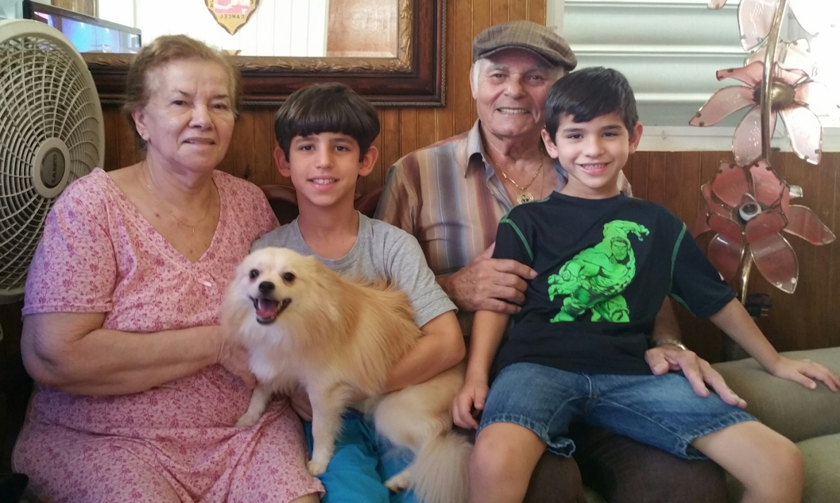
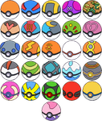
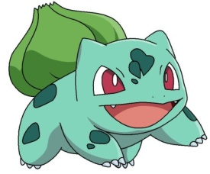

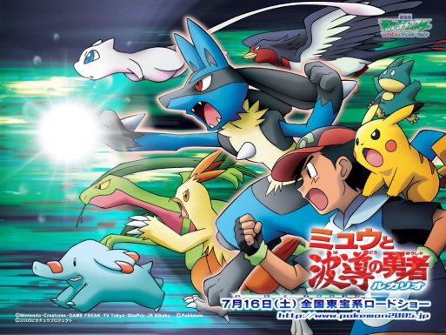
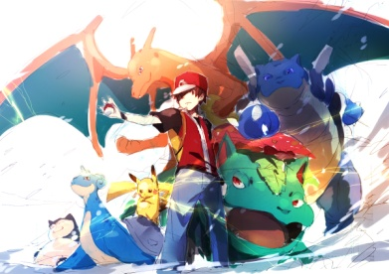
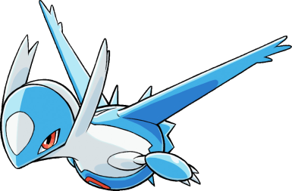
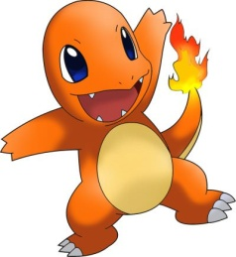
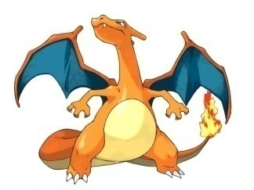
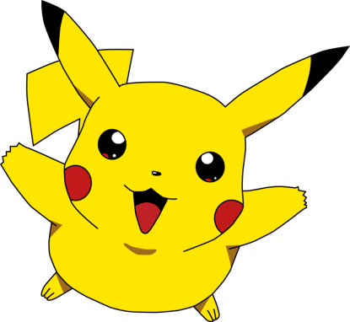
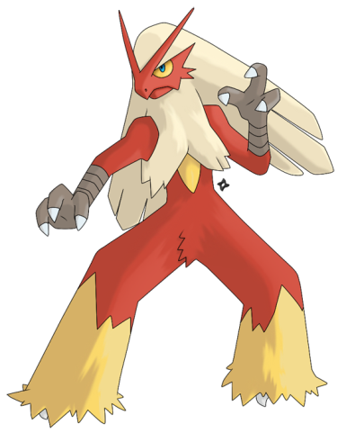
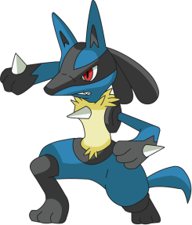

Tu eres especial para mi por que tu me queres mucho. Bryan

Slide 13


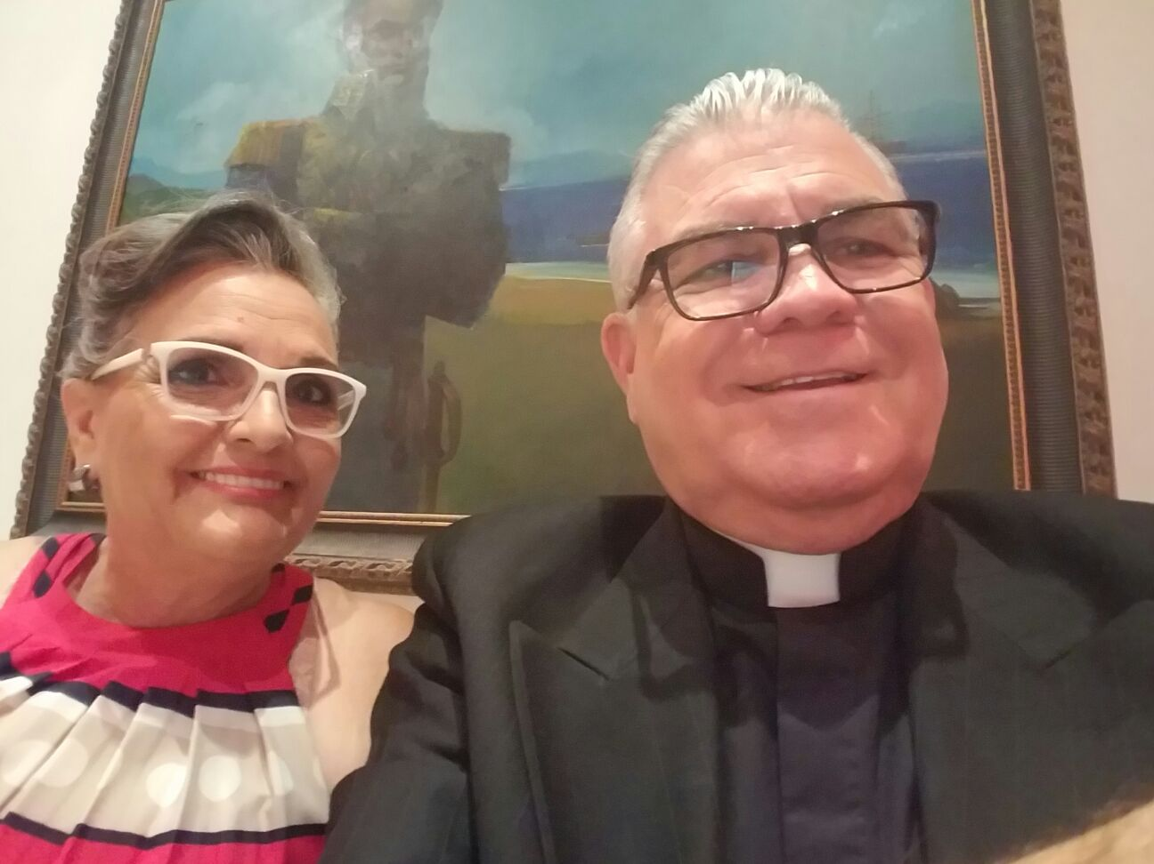
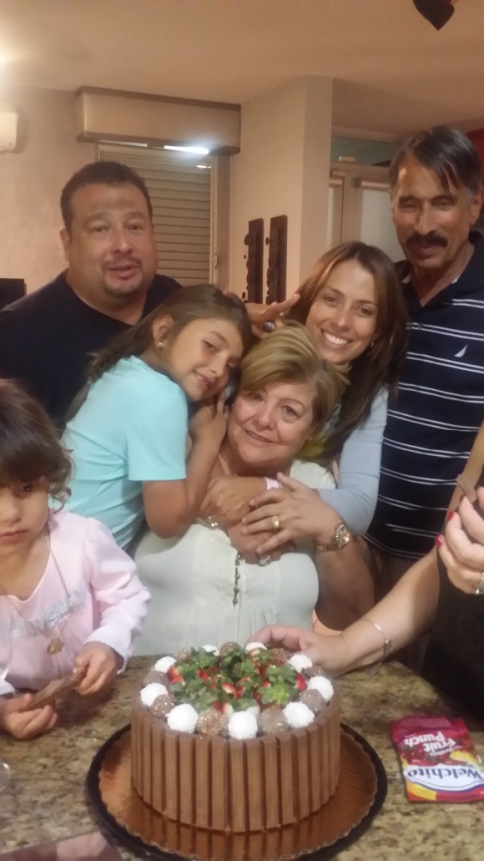
YOU TEACH ME HOW TO CONSERVATE THINGS.
YOU ARE SO SPECIAL TO ME.
HGPD GLADYANNE

Slide 14
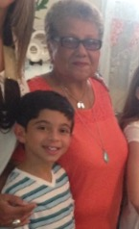

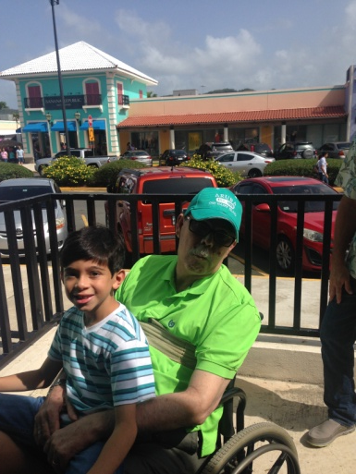
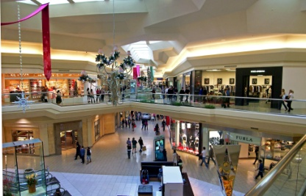

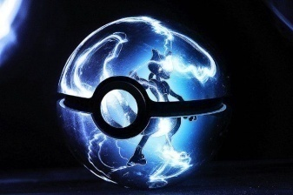
I love you because you MAKE ME LAUGH.
love Gustavo

Slide 15
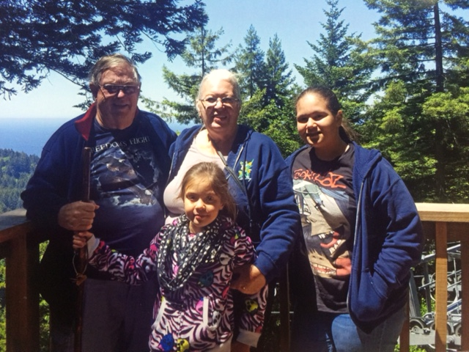


I love you because you cook the best cakes! Love,Amanda

Slide 16
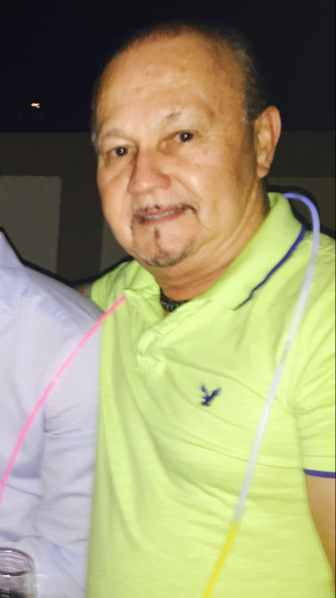
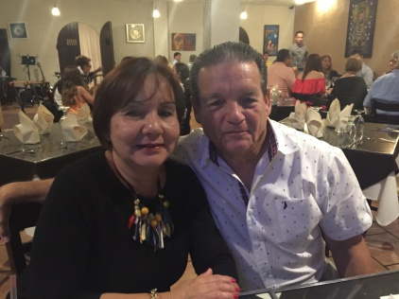
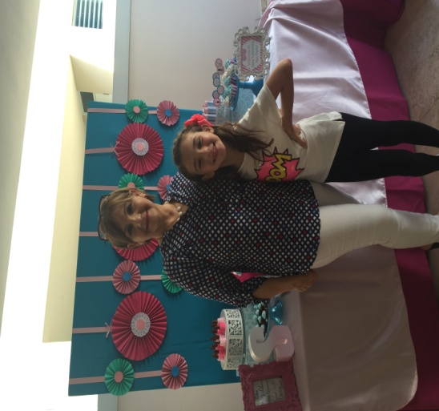
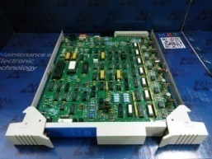

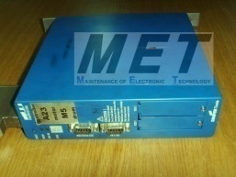


I LOVE YOU BECAUSE YOU PLAY A LOT OF GAMES WITH ME!
LOVE “SARA V”

Slide 17

Los amo a los dos. Camila

Slide 18

I love you grandma because you make the best food in the world !
Love,Jazmin

Slide 19
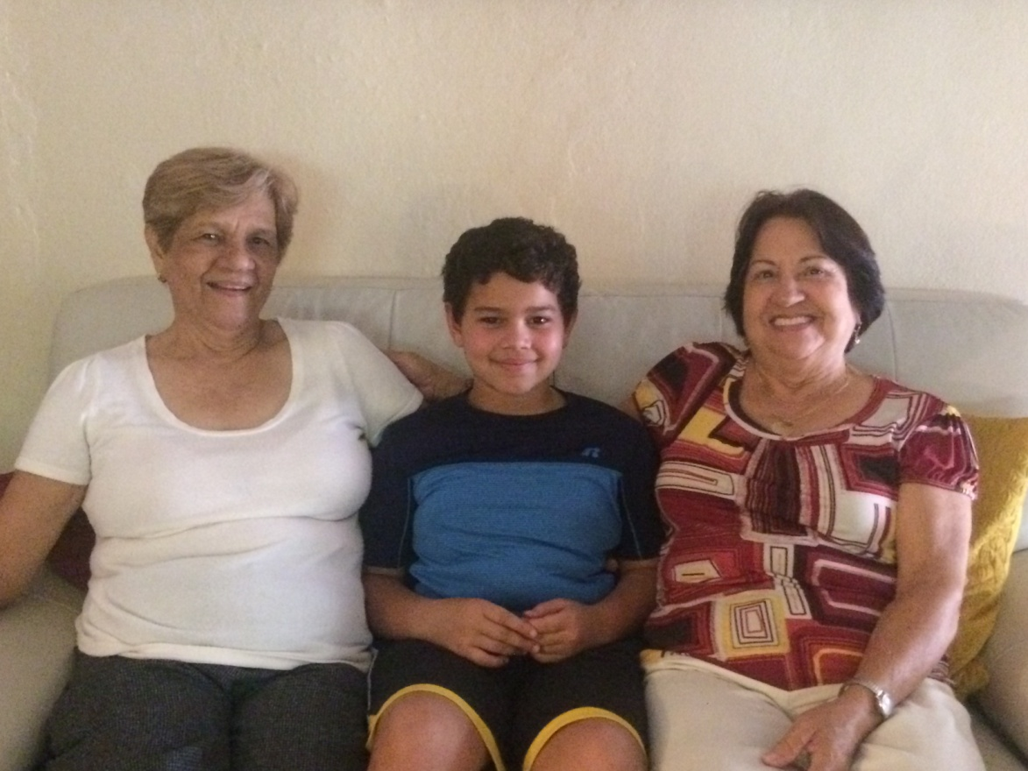
I love you because you take
me to the mall.
Love Nicolas.

Slide 20


I love you Grandma because you make the best food ever in the world!
Love,Alanis

Slide 21


YO TE AMO PORQUE ERES ESPECIAL PARA MI.DE Fatima

Slide 22


I love you because you play basketball with me. Love Abdiel.

Slide 23







You are so special to me happy grand parents day I love you
From Hakeem

Slide 24


I love you because teach me how to play!!!!! LOVE, EDSON

Slide 25




I love you because you cook the best food and because you are the best at everything! love Andres

Slide 26





Te amo porque tu me llevas a el molo san juan.tu cosinas bien bueno y rico. Te amo mucho mucho. Sareh.

Slide 27


I love you because you cook the best lasagna, spaghetti, and TUNA!!!
I love you.
Love, Your Princess, Ann

Slide 28



I love you because you take me to Papa Johns! Love Martin

Slide 29




Grandpa I love you because you make laugh .
I love you! Robin

Slide 30


I love you because you are the best at basketball
Love Caleb.

Slide 31









I love you because you cook very good. I love you because you teach me how to be good at math! Love NOAM

Slide 32







I Love because you cook the best food$$$$$$$$$$$$ Love Delbert

Slide 33


I love you because you are the best at being nice to me and loving me a lot. Love Thomas

Slide 34


You make me my favorite food. I love you so much. Alondra

Slide 35






I love you because you take me to wherever I want!
I love you because you make me smile when you give me gifts! Love Rocio

Slide 36










I love you because you take me to the park!
Love, Lorenzo

Slide 37


Happy GRANDPARENT DAY I LOVE YOU BECAUSE YOU TAKE ME TO DIFFERENT PLACES
FROM RICARDO FARINACCI HATTON

Slide 38



I love because you make me smile when you give me a hug!
love Viviana

Slide 39



I love you because you play in the pool with me!
Love, Adrian

Slide 40



I love you Grandma because you take me to the movies!
LOVE CAROLINA

Slide 41



TEAMO ABOELA LUISA CON MI CORASON I LOVE YOU .EMILIO

Slide 42



I love you because you make me laugh when you tickle me.
Love Alejandro

Slide 43



I love you because you are the best at teach me how to play soccer. I love you. David

Slide 44




I love you because you make me laugh when you play with me ,love Viviana

Slide 45



I love you because you cook the best broccoli!
love,
Grady

Slide 46



I love you because you take care of me and have fun with me
Love Laura

Slide 47



I love you because you take me to cool places. Love you so much. Happy Grandparents Day. Oliver

Slide 48


! I love you because you make the best cookies Love, Isabella

Slide 49






I love you because you make me smile when you hold me!
MARCELA CHLOE .P.

Slide 50


Te amo
Feliz Dia De Los Abuelos
Abu llo te amo porque tu juegas juegos con migo como aserme cosquillas y me ases reir y te ries con migo.
Te amo mucho.Paulette
Te amo

Slide 51


Te amo porque me dan muchas cosas y porque me dan muchos abrasos Te amo mucho Amanda.

Slide 52






I Love you because you make me laugh when you do magic. I love you because you cook the best rice with beans and steak! LOVE:LAURA!

Slide 53


LOVE YOU BECAUSE YOU MAKE ME LAUGH WHEN YOU PLAY WITH ME AND SAY JOKES!
LOVE, EUGENIA

Slide 54







I Love you Grandma because you take me to McDonalds.
Love Derek

Slide 55


Te amo mucho porque me das muchos abrasos y besos y tambien porque me compras muchas cosas de Gabrielle que tengas un lindo dia de Abuelos

Slide 56





I love you because you make me smile!
Love Sofia

Slide 57




I love you because you make me laugh

Slide 58



I LOVE YOU because you make me laugh when you make funny jokes I love you because you let me go to toys' arouse. Form Gustavo cruz

Slide 59

I love you because you take me to farms Love Ian

Slide 60



I love you because you teach me how to tie my shoe.
Love Paola

Slide 61
Thank You for Coming
We Love Our Grandparents

